Slide 1
Online Community Building and e-Activism

Slide 2
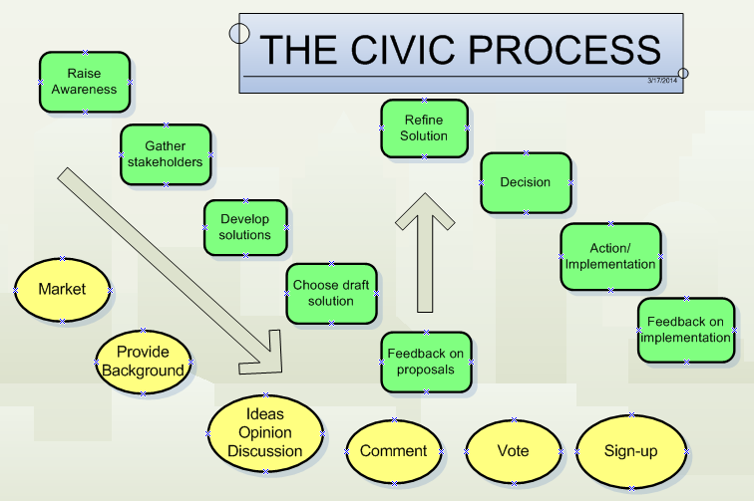

Slide 3















An expanding toolkit

Slide 4

Creating Community Solutions Nat’l Dialogue on Mental Health
INNOVTIONS
http://www.creatingcommunitysolutions.org/resources

Slide 5
The Conundrum!
Post it where? How often?
Email
Facebook
Twitter
Website
Street kiosk
Newspaper
Etc etc etc

Slide 6
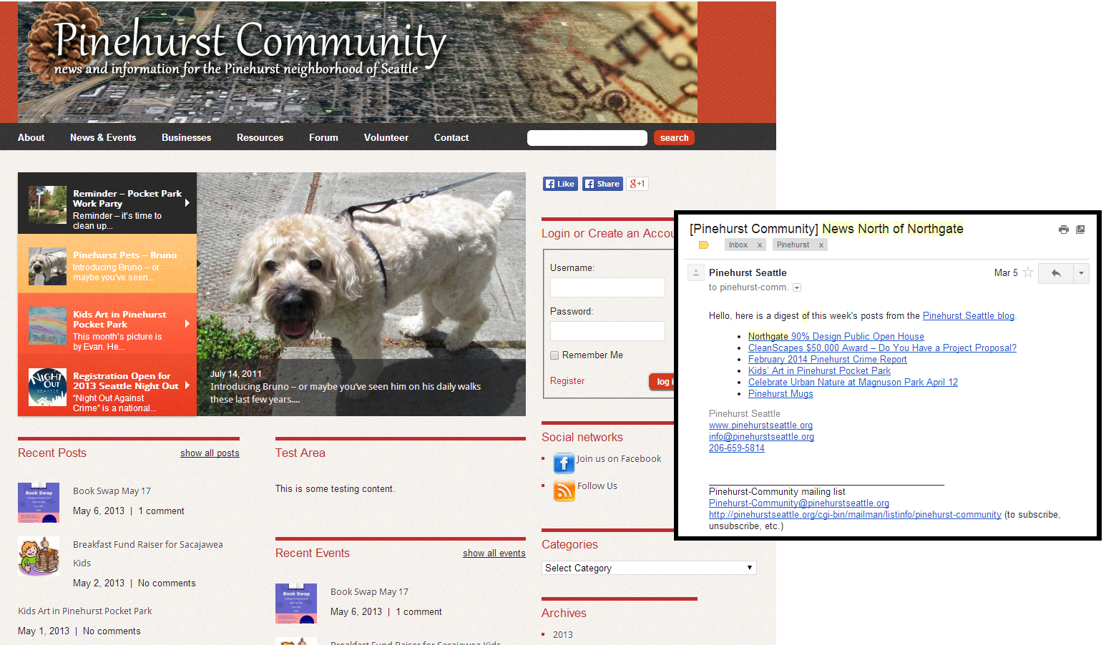
What’s working for us?
Email List (~400 people)
http://www.pinehurstseattle.org (update coming soon)

Slide 7
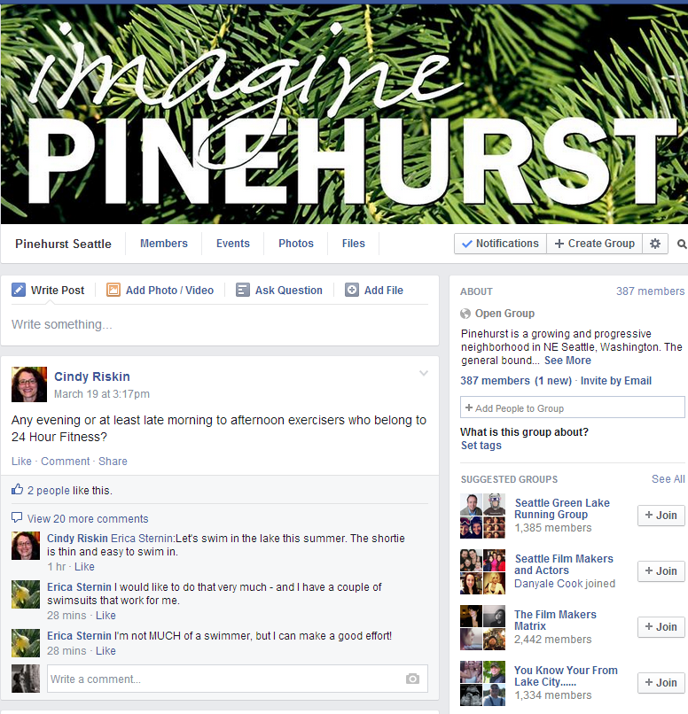
F A C E B O O K

Slide 8
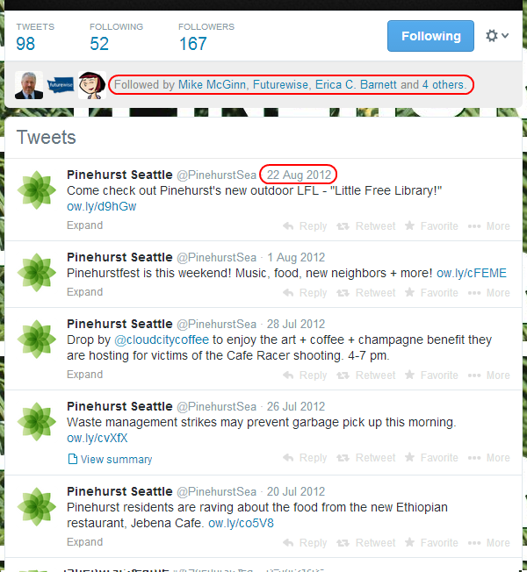
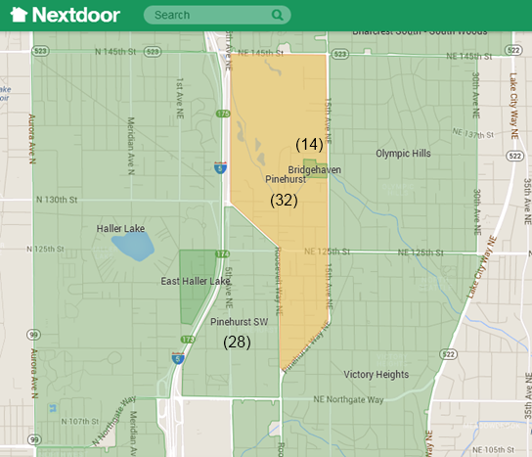
What We’re
Not Embracing
(yet)

Slide 9
What Next For Pinehurst?
More involvement – We’ve got 400-600 people in a 9600 person neighborhood on our various lists.
A small fraction of that participate regularly.
More diversity of participation:
Race, income, renters
Group 001200-3 has a median income of $26,786 and is Whites:65.5%, Hispanics:5.1%, Blacks:12.8%, Asians:12.9%, Others:8.8%
Group 000600-6 has a median income of $75,750 and is Whites:59.6%, Hispanics:7.1%, Blacks:9.4%, Asians:21.6%, Others:9.4%
Other tools?

Slide 10
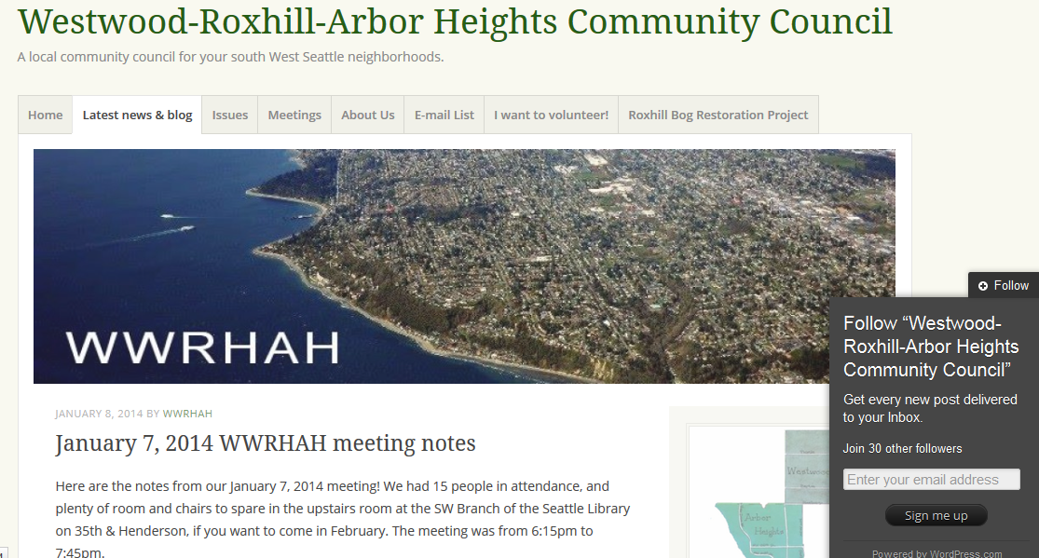
What’s working for us?
wwrhah.wordpress.com

Slide 11
Small discussion
What’s working for us?
What’s not?
What would we like to do?

Slide 12
City Data

Slide 13
Access to devices
89% have cell phones
58% have smart phones
More laptops (72%) & mobile (smartphone & tablets, 66%) than desktops (55%).
Higher education: more likely to use and own computer, smartphone or tablet.
Those with more than one internet device tend to be younger, male, and have more income.

Slide 14
Adoption
Skills & uses show more gaps than access
Education & income show greatest differences
Age & ethnicity too
About ¼ not comfortable using attachments.
Focus groups: trust, privacy, safety concerns
Less likely to buy online, look for health info, or get computer answers.
Notes:
Nearly 77% use email on a regular basis, about ¼ aren’t comfortable using attachments.

Slide 15
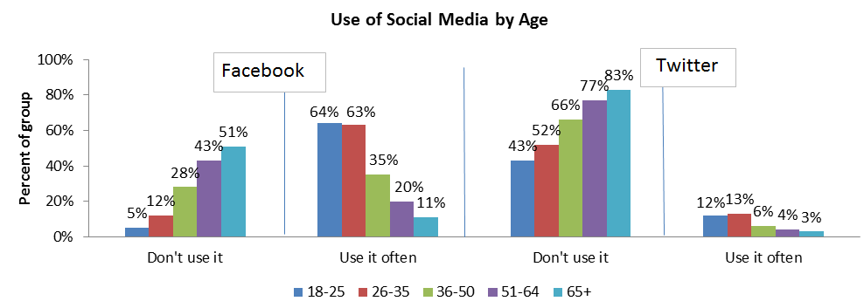
Social media use by age

Slide 16
Engagement
53% participate in community group
¾ want to share opinion electronically
Email preferred
Facebook mentioned more by least educated in phone survey
Notes:
David

Slide 17
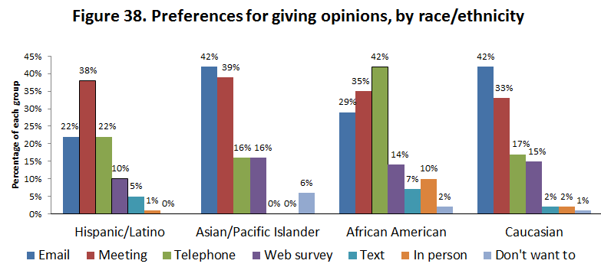

Slide 19
Adoption
Low Tech Low Engagement | Low Tech High Engagement
High Tech Low Engagement | High Tech High Engagement

Slide 20
Community Build vs Innovate (Shiny New Object)
The developers allure
Careful about testing – think small pilots first.
Need to factor in community’s current comfort, communications and learning needs

Slide 21
Campaigning
Online activities supporting offline

Slide 22
Strategy exercise
Pick a topic and plan activities on and offline over 4 months.

Slide 23
Tips for multilingual
Bing/Google translate can be embedded
Don’t rely on them
Short abstract can be enough to identify interest
Better deep than wide
Consider video shorts
Translation teams needed

Slide 24
City resources

Slide 25
Other good e-civic resources
Matt Leighninger
America Speaks
Shelly / Andres’s tool?

Slide 26
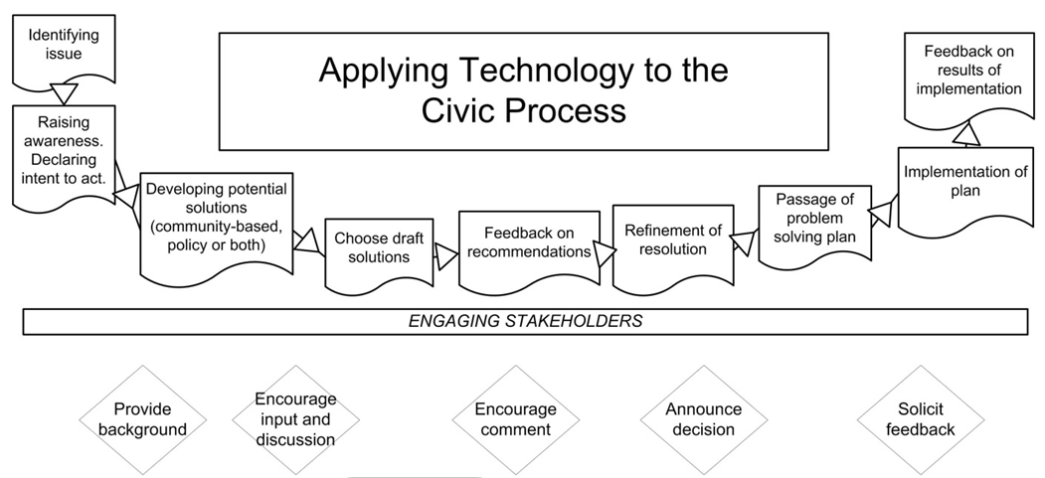

Slide 27
Idealware
Techsoup.org

Slide 28
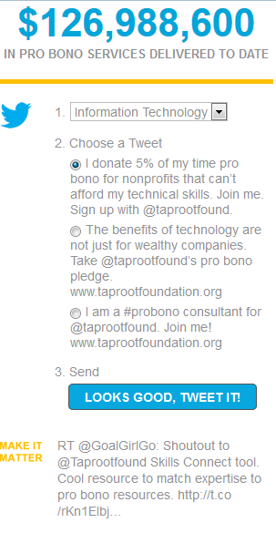
Taproot Foundation
Tweet a message from their web site when you sign up to volunteer.

